Slide 1
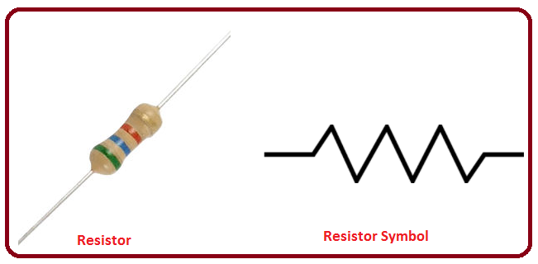
Resistance and Resistivity

Slide 2
What causes resistance?
E-field in conductor (resistor) is provided by a battery or voltage source.
  Charges (electrons) are put in motion due to influences of the electric field, but scatter in a very short time from things that get in the way
  defects, lattice vibrations (phonons), etc
  The more collisions, the greater the resistance and the fewer the collisions, the less the resistance.
Imagine the following two scenarios.
  Running down the hallway in between periods
  Running down the hallway after the late bell when there is nobody in them.
  Under which scenario would you experience less resistance?

Slide 3
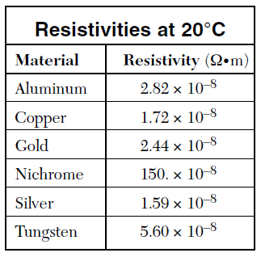
Resistivity & Resistance
Resistivity is a measure of the conductive ability of the material (Think of the free flow of electrons).
Resistivity is an intrinsic (natural) property of a material.
The higher the resistivity, the higher the resistance and vice versa.
For a conductor of length L (m) and cross-sectional area A (m²), the resistance can be determined by:
R = ρL/A
    Where
    ρ = resistivity (Ω•m)
    L = length of the conductor
    A = Cross-Sectional Area

Slide 4
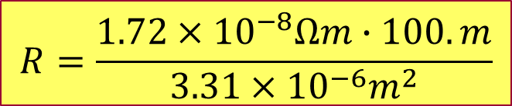
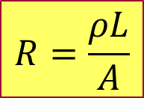

Example 1:
What is the resistance in a copper wire 100.m in length with a cross sectional area of 3.31 mm²?
  You will need your reference table to obtain the resistivity of copper.
$$R=\frac{ρL}{A}$$
$$R=\frac{1.72×{10}^{−8}Ωm∙100.m}{3.31×{10}^{−6}m^{2}}$$
$$R=0.520Ω$$

Slide 5
Ex.: Resistance & Resistivity
What would happen to the resistance in a wire if the length were increased?
  It would decrease.
  It would increase.
  It would remain the same.
What would happen to the resistance in a wire if the cross-sectional area were increased?
  It would decrease.
  It would increase.
  It would remain the same.
What would happen to the resistivity if the length were increased?
  It would decrease.
  It would increase.
  It would remain the same.

Slide 6
Low Resistance vs.
High Resistance
To Summarize:
  Short fat wires make good conductors.
  While long skinny wires make poor conductors.
I
Short & Fat = Low Resistance
I
Long & Skinny = High Resistance

Slide 7
Resistance vs. Length and
Resistance vs. X-Sectional Area
What is the relationship between:
Resistance and Length? | Resistance and X-Sectional Area?
Resistance
Resistance
Length
X-Sectional Area

Slide 8
Resistivity vs. Temperature
Is resistivity really constant?
Not all the time.
Note: The Resistivity is zero at 0 K, therefore, the resistance is also zero.

Slide 9

How fast do the electrons travel?
A simple observation would tell an observer that the flow of electricity appears to be instantaneous when flipping on a light switch.
Does that mean the electrons travel at the speed of light?

Slide 10
Drift Velocity
When an electric field is applied to a conductor, it will set the electrons in motion in an overall direction opposite the applied field.
While the electric field travels at nearly the speed of light, the overall speed of the electron from one end of the conductor to the other is quite slow and random in direction due to collisions.
+
+
+
+
+
+
+
+
+
+
-
-
-
-
-
-
-
-
-
-
e

Slide 11
Determining the drift velocity in a wire.
The total charge in a section of wire can be determined as follows:
  Where:
    n = number of carriers per unit volume
    A = cross-sectional area
    L = length of the conductor
    e = charge of an electron (the elementary charge)

Slide 12
Determining the drift velocity in a wire.
Since all the electrons move along the conductor at the same average drift speed, the total amount of charge that moves through a cross section of wire is:
Since v = d/t, we can find the time it takes for the total charge to move through any cross section by:
  Where v_{d} = drift velocity and L = length of wire.

Slide 13
Determining the drift velocity in a wire.
Substituting (1) into (2) for q, and (3) into (2) for q, and then solving for v_{d} gives us:
The number of charge carriers per unit volume (n) can be found as follows:
  Where: N_{A} = Avogadro's Number
  M = the atomic mass number
  ρ = density

Slide 14
Example – Drift Velocity
What is the drift velocity in the copper wires leading to a kitchen appliance that operates at 1 Ampere?
  Note: wire in your kitchen has to be capable of carrying 20 amps of current, therefore, it is specified to be 12 gauge.
  The cross-sectional area of 12 gauge wiring is 3.31 x 10⁻⁶ m²
  Assume that 1 electron is donated by each atom.
  The density is 8.96 x 10³ kg/m³.
  The atomic mass is 63.546 g/mole.

Slide 15
Finding the Drift Velocity in a Copper Wire
First determine the number of charges per unit of volume (n)
Now determine the drift velocity (v_{d})
That’s only 0.08 m/hr!

Slide 16
Key Ideas
A circuit is a closed path where current can flow.
Current is the flow of charge.
Resistance is the hindrance to the flow of charge.
Ohm’s Law = voltage to current ratio (V/I) = Resistance.
Resistivity is an intrinsic property of a material that is proportional the the resistance.
An increase in length of a conductor will increase resistance.
An increase in cross-sectional area of a conductor will decrease resistance.

